Slide 1
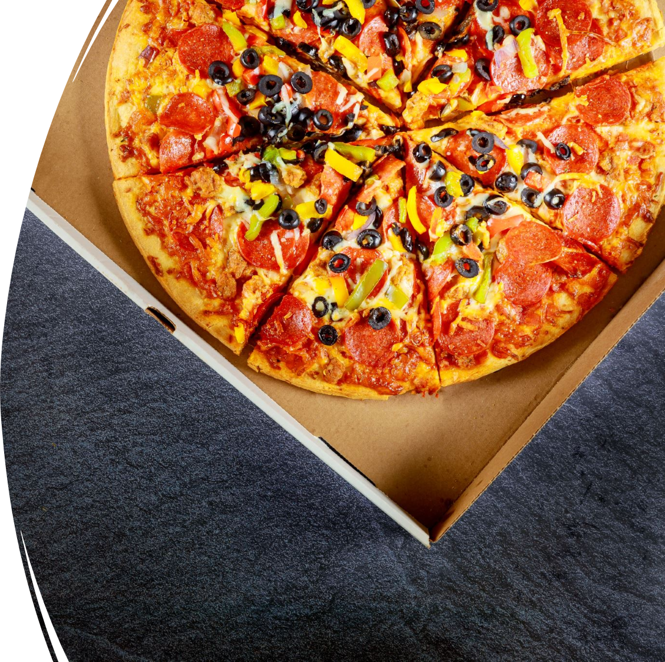
PIZZA
The main objective of this project is to analyze retail sales data to gain actionable insights that will enhance the performance of the Pizza place

Slide 2
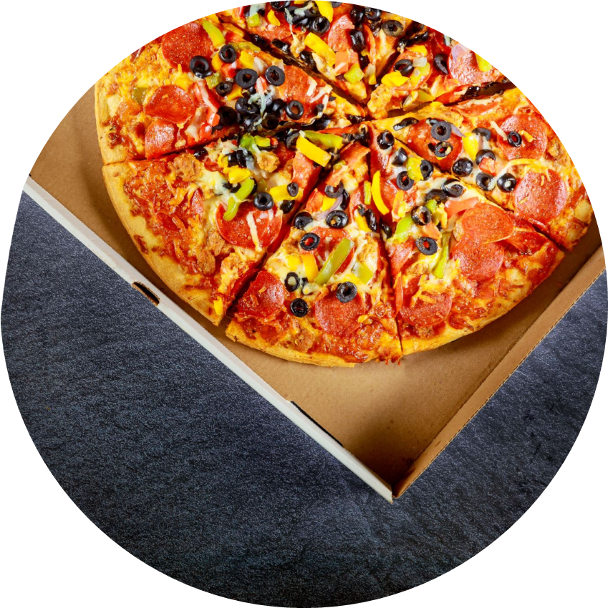
PLANNED ANALYSIS
How do sales vary by day of the week ad hour of the day?
Are there any peak time for sales activity?
What is the total sales revenue for each month?
Which products are top best selling in terms of revenue?
How do sales vary by product category and sizes?
Are there any pizzas we should take of the menu such as bottom selling pizzas?
How much sales we did this year?
Any Seasonality in Sales?
How many Pizzas do customers order on average?

Slide 3

POWER QWERY EDITOR
In power query editor from products extracted the sizes
Transformed the products columns with sizes to only products
Formatted the datatypes
Using conditional column updated price for every size and category of pizza
Total bill = quantity * unit price ( change the datatype to currency)
Added Custom column to calculate total bill

Slide 4
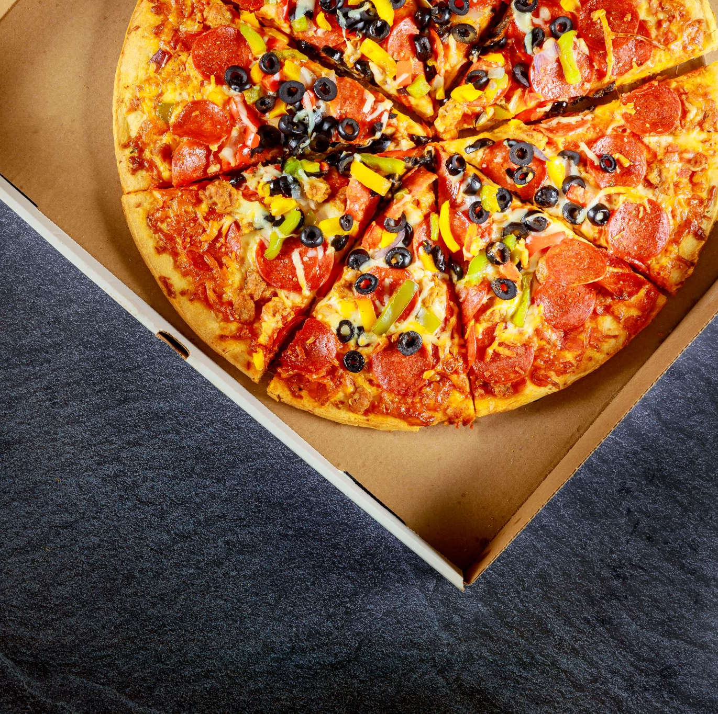
COLUMS ADDED
Created individual column for MONTH NAME, DAY NAME, TIME OF THE DAY & TOTAL HOUR from the Order Date and time column using Power Query.
From the Pizza_id column , added column using Custom Column Function and replaced id with the Pizza names and sizes

Slide 5
PIVOT TABLE CALCULATIONS
After loading the power query table , Created pivot tables for the
Count of Quantity vs Total Hours
Total Sum on Weekdays
Total Count on Weekdays
Total Sum on Month wise
Pizza Categories and its Total Sum
Pizza Categories and its Total Count
Top 10 Selling Pizzas
Bottom !0 Selling Pizzas

Slide 6
DASHBOARD
Created Bar charts & Pie charts for quick Analysis and Insights on
Quantity Ordered Based on Hour
Comparison of Size Ordered
Categories Percentage of Distribution.
Top 10 Selling Pizzas
Bottom 10 Selling Pizzas
Order on Weekdays

Slide 7

SLICERS & MEASURES
Created Slicers on Month Name and Day names
Created Measures on
Total Sales
Total Footfall
Average Bill per person
Average Order per person

Slide 8
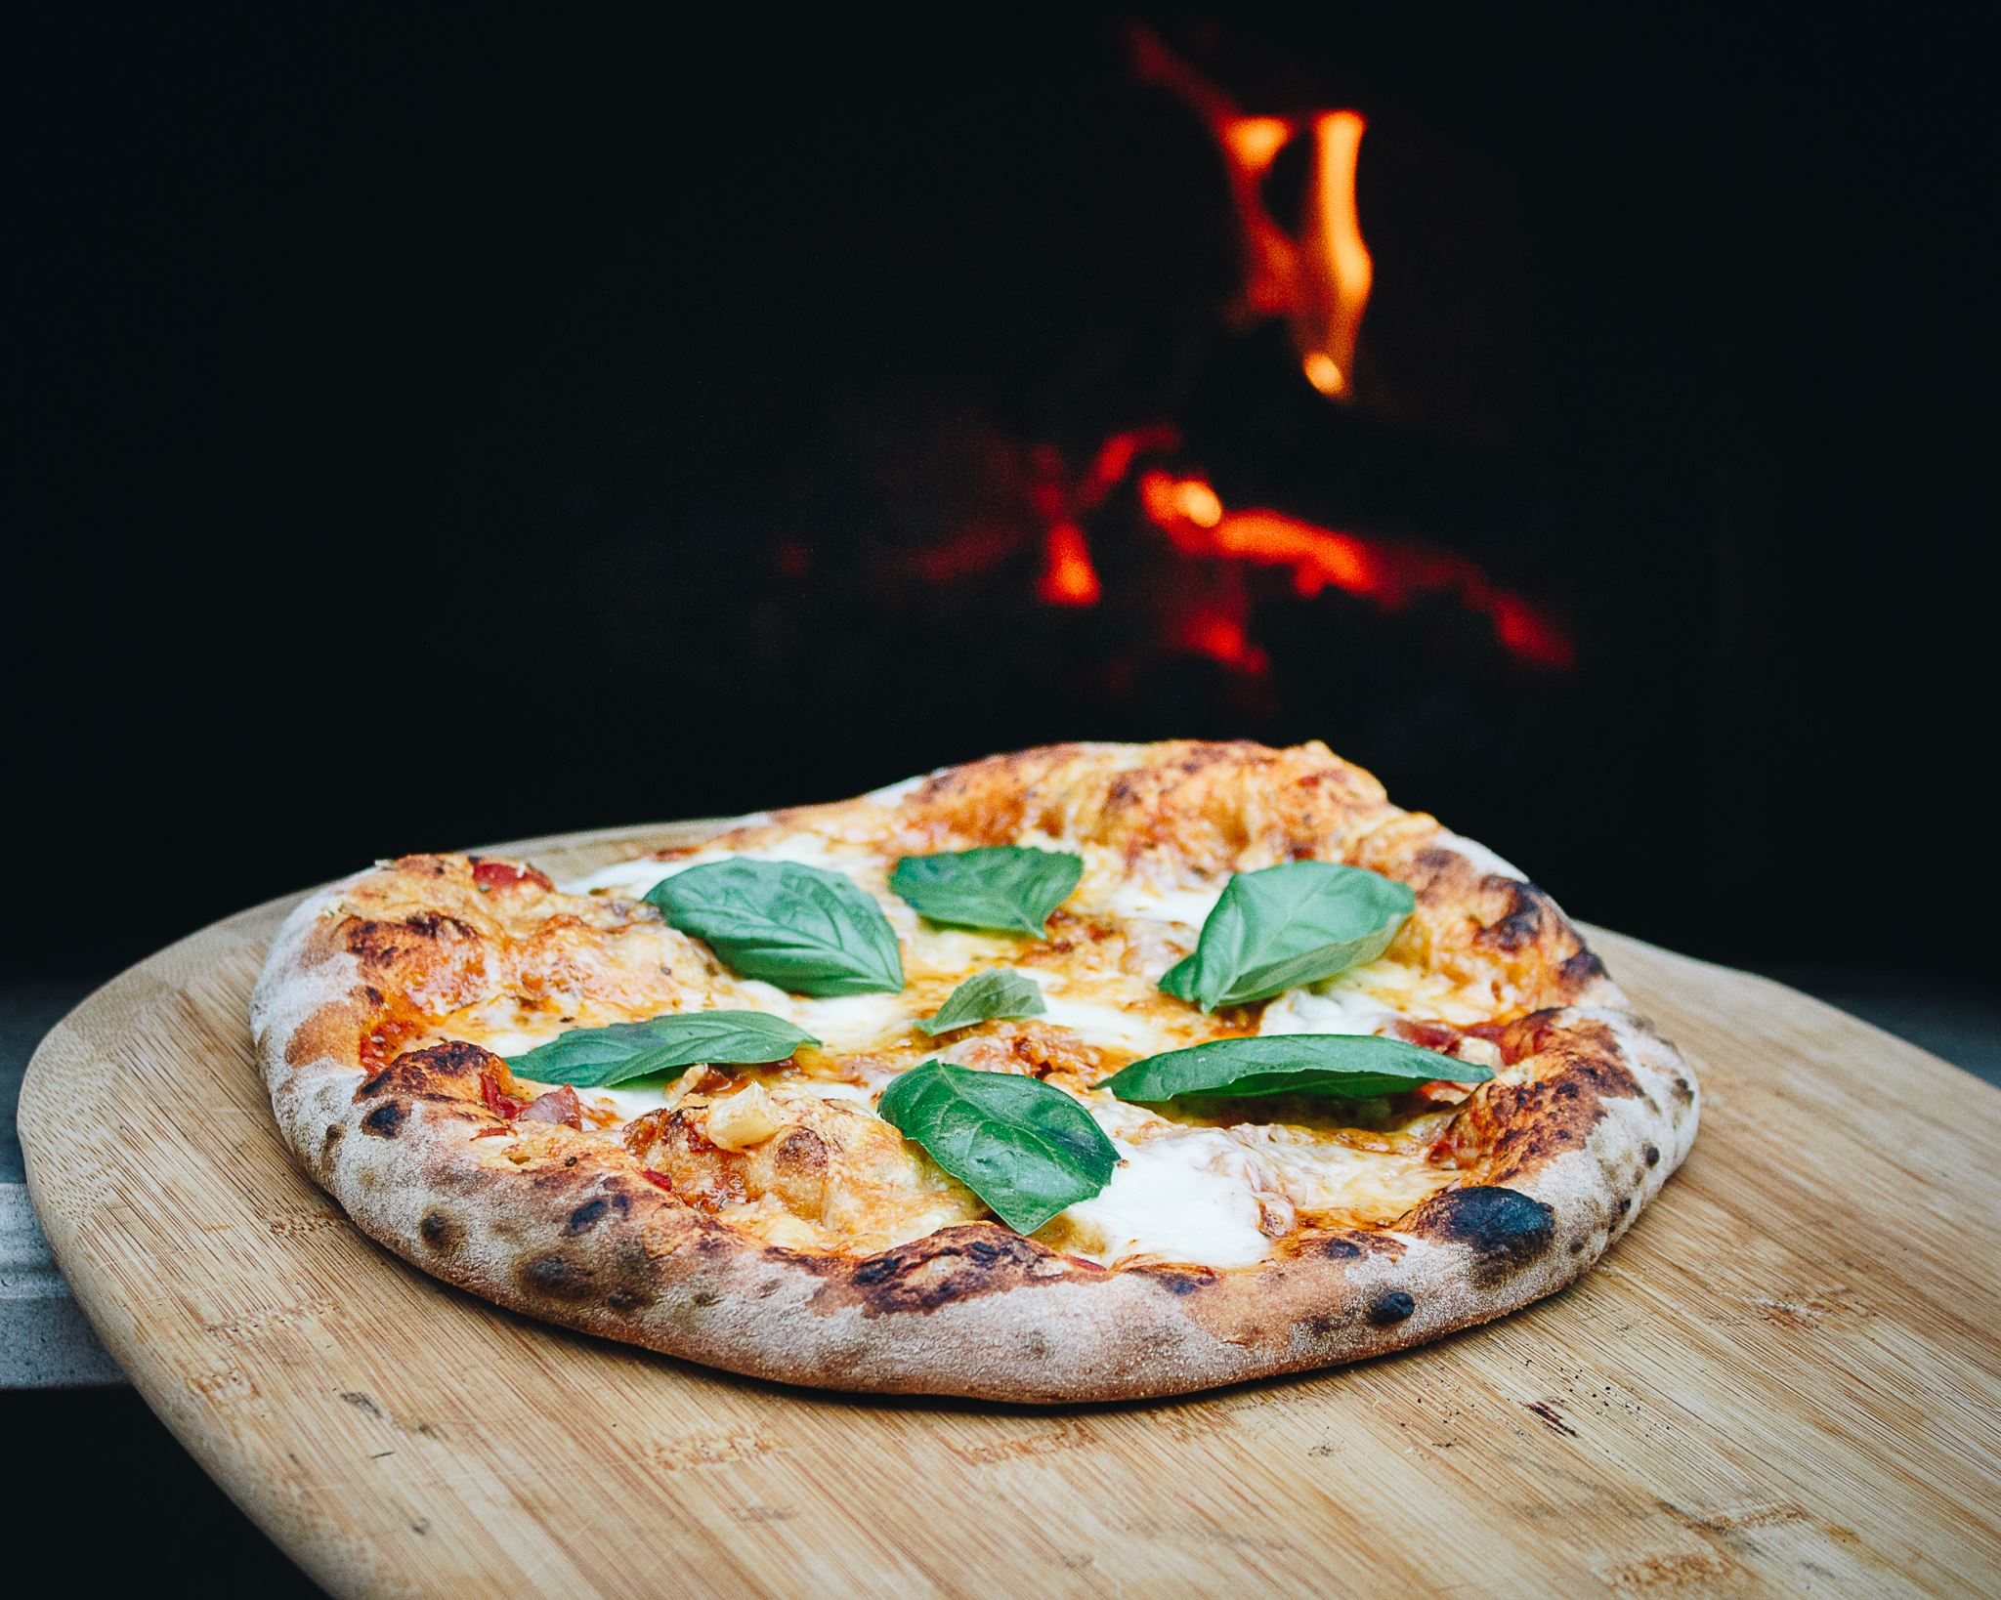
INSIGHTS
How do sales vary by day of the week ad hour of the day?
From the insights , On weekends there is a peak in sales on evenings (6-8) .
Around 400 quantities of Pizzas are been sold on Weekend, whereas on weekdays evenings its around 300 quantities.
Surprisingly, all days in the week, mid Morning (around 11,12,1 ) have recorded good sales of plus 400 quantity of pizzas.
Mid afternoons(2,3,4) throught the week records a dip in sales

Slide 9
INSIGHTS
2. Are there any peak time for sales activity?
Yes from the insights the mid mornings(11pm,12pm,1pm ) and evenings(6 – 8 pm) records peak time in sales activity.
3. What is the total sales revenue for each month?

Slide 10
INSIGHTS
4. Which products are top best selling in terms of revenue?
5. Are there any pizzas we should take of the menu such as bottom selling pizzas?
These are the 5 Bottom
selling Pizzas.
The Soppressata Pizza has
The lowest sales of just 8022$.
It can be considered to take of
from the menu

Slide 11
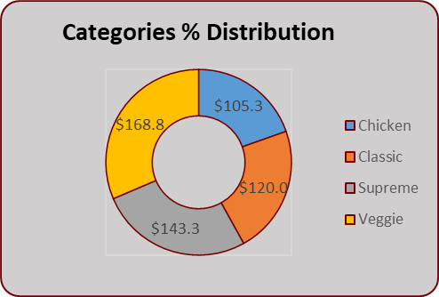
INSIGHTS
6. Are there any pizzas we should take of the menu such as bottom selling pizzas?
According to Sizes ,
Large pizza has the most sales over 48%,followed by medium pizza 30% and small 22%
According to Categories,
Surprisingly Veggie Category has most sales 168$ , followed by Supreme (143$) and Classic(120$). The Chicken Category rec ords the least with(105.3 ) sales.

Slide 12
INSIGHTS
7. How much sales we did this year?
Total Sales this Year is 817860.05
8.Any Seasonality in Sales?
The July month has recorded the maximum sales of
$32,480.60
Also, the Summer Season(March,April,May) have recorded a good consistent sales around $30,899.35 , $30,183.00 and $31,260.55
9.How many Pizzas do customers order on average?
On average customers order 1 pizza per person.

